Slide 1
Image-Based 3D Textured body Reasoning
Yuchen Luo
Shanghai Jiao Tong University

Slide 2
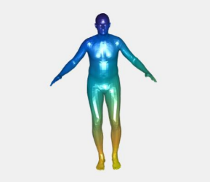
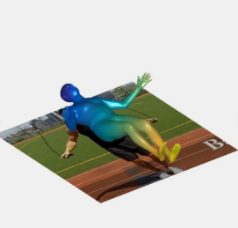

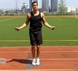
Aligned
UV Mapping
Supervised Training
Decoder
Encoder
No 3D details! No Texture!
Yao, P., Fang, Z., Wu, F., Feng, Y., & Li, J. (2019). DenseBody: Directly Regressing Dense 3D Human Pose and Shape From a Single Color Image. Retrieved from https://arxiv.org/pdf/1903.10153.pdf

Slide 3
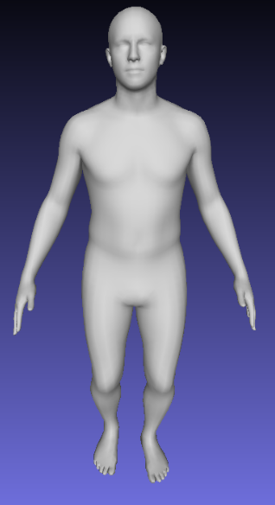
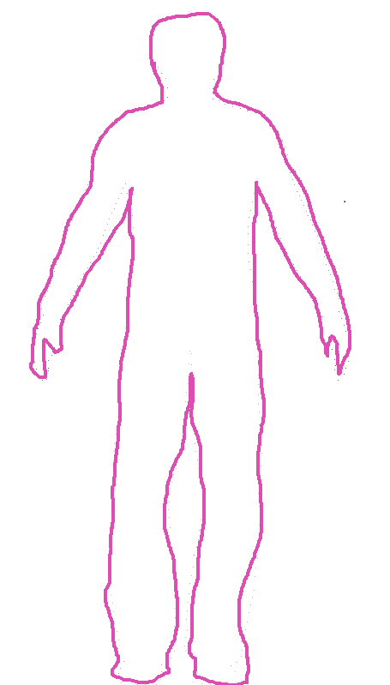
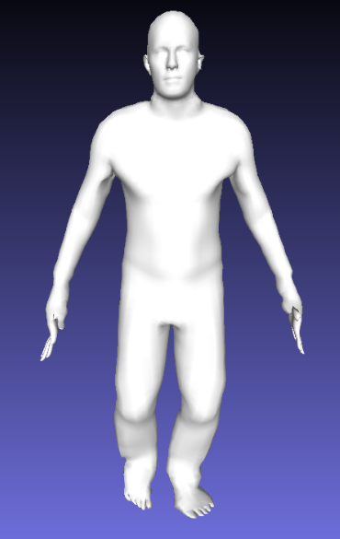
Middle-Level Details Recovery
Naked Body
Detailed Boundary
Detailed Body
Unsupervised
Aligned
Deform
UV Mapping
Supervised Training
Decoder
Encoder

Slide 4
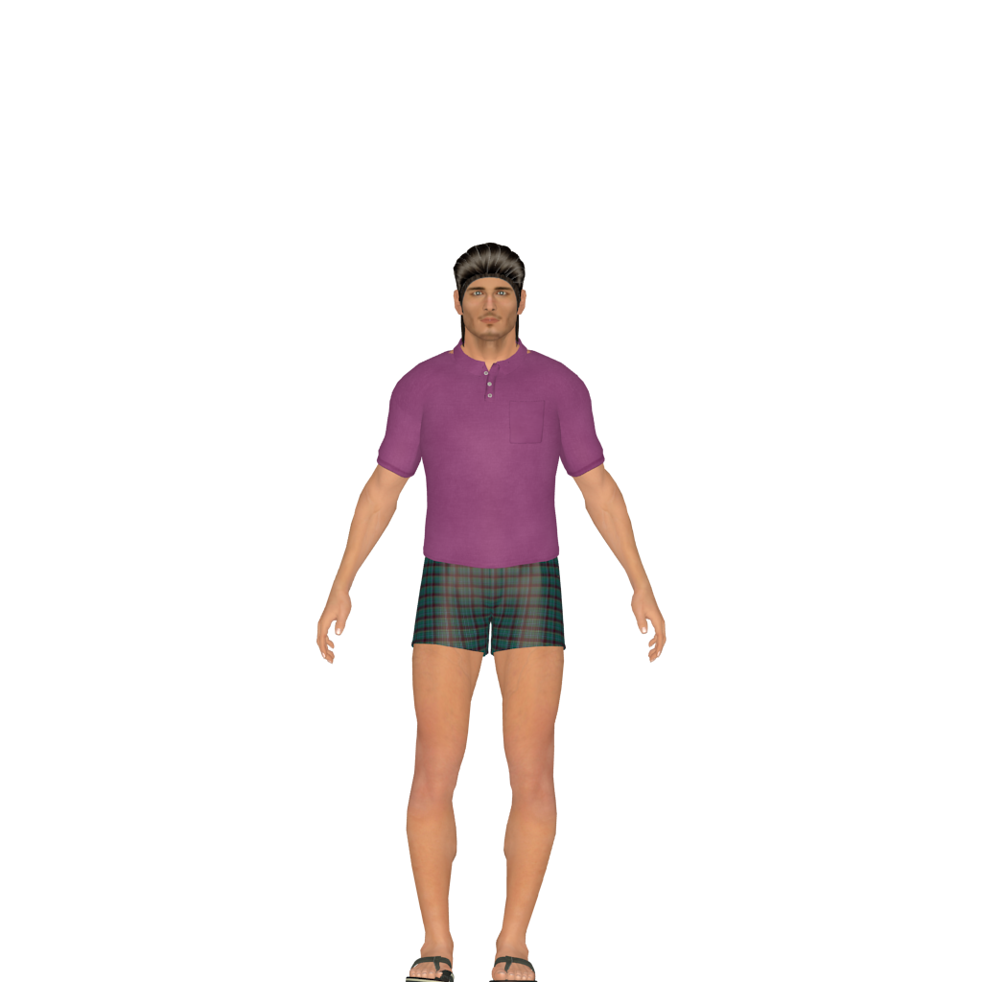
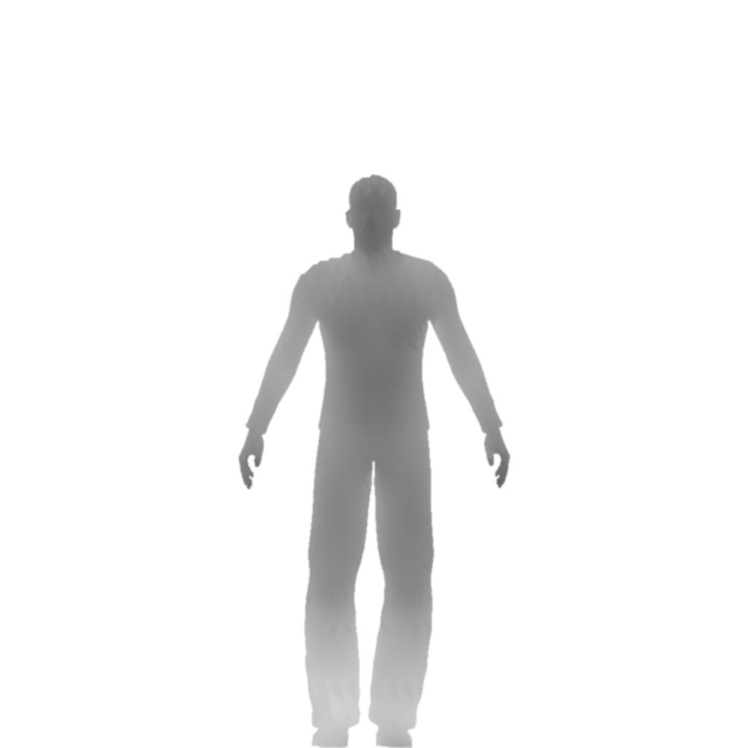
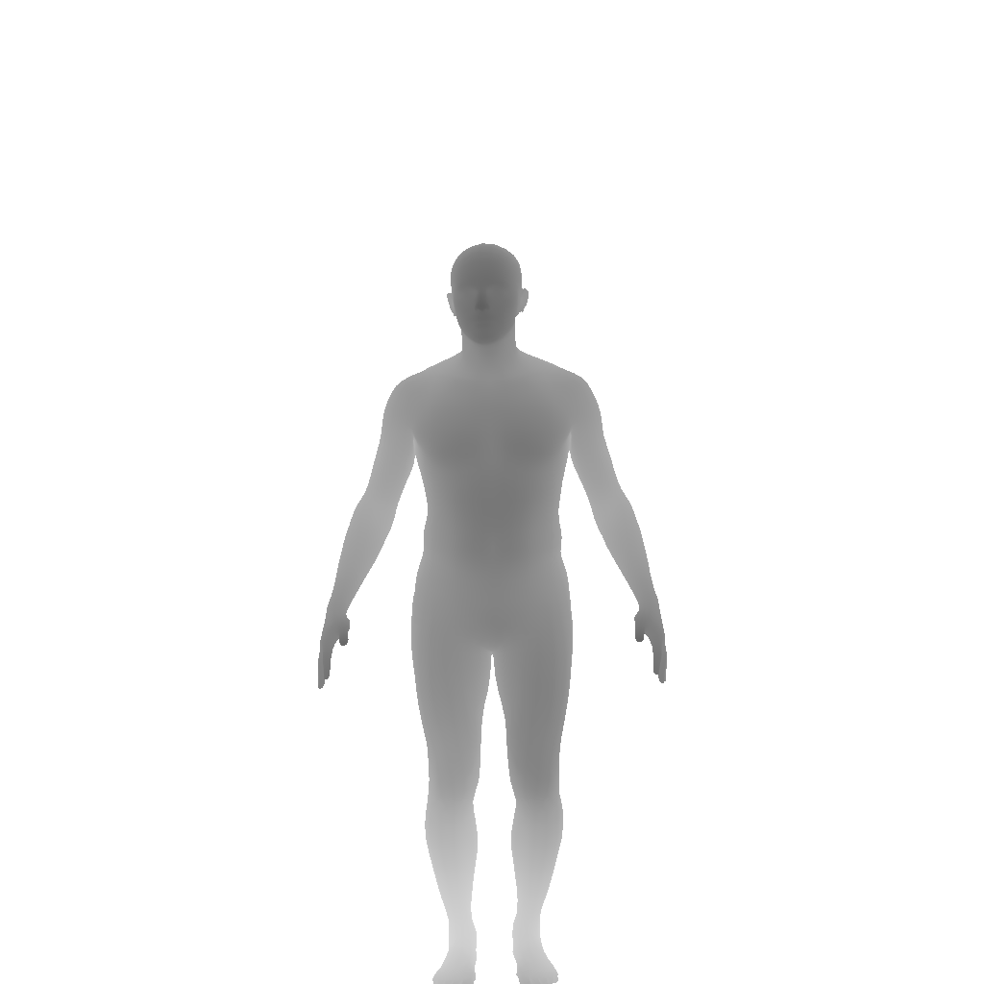
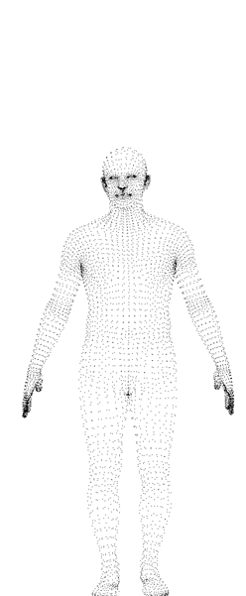
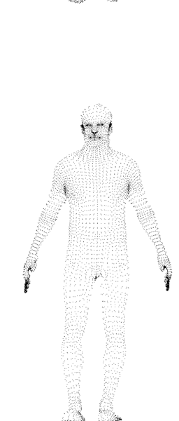
mean- value coordinates
M. S. Floater. Mean value coordinates. Computer aided geometric design, 20(1):19–27, 2003

Slide 5
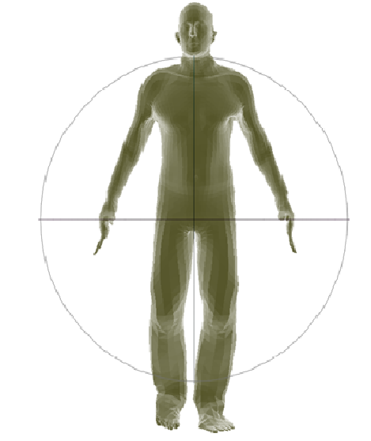
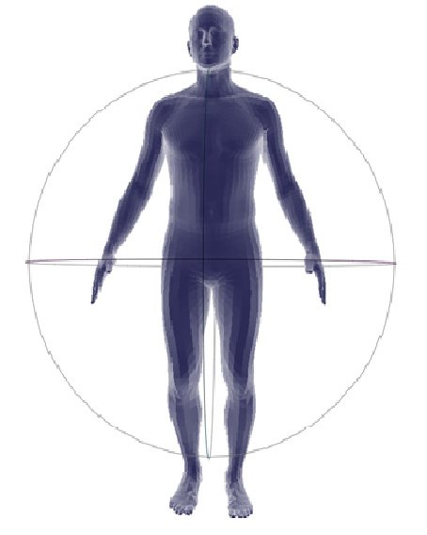
mean- value coordinates
M. S. Floater. Mean value coordinates. Computer aided geometric design, 20(1):19–27, 2003

Slide 6
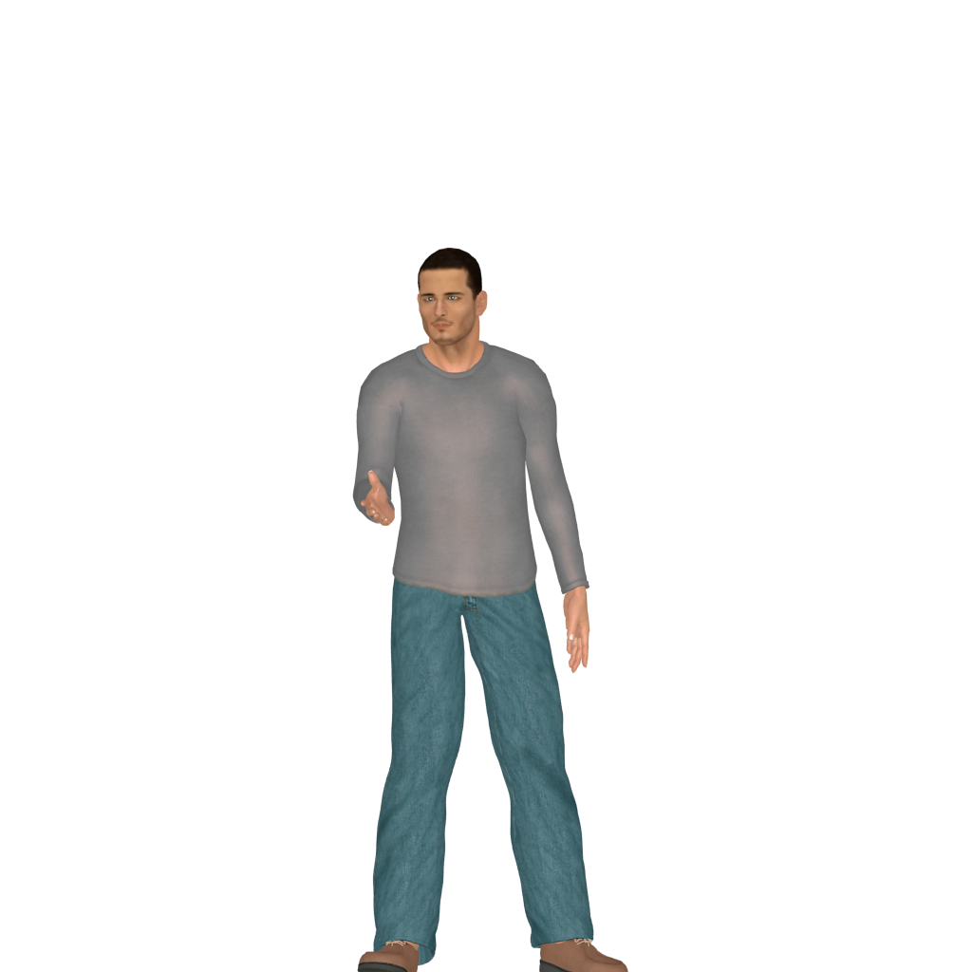
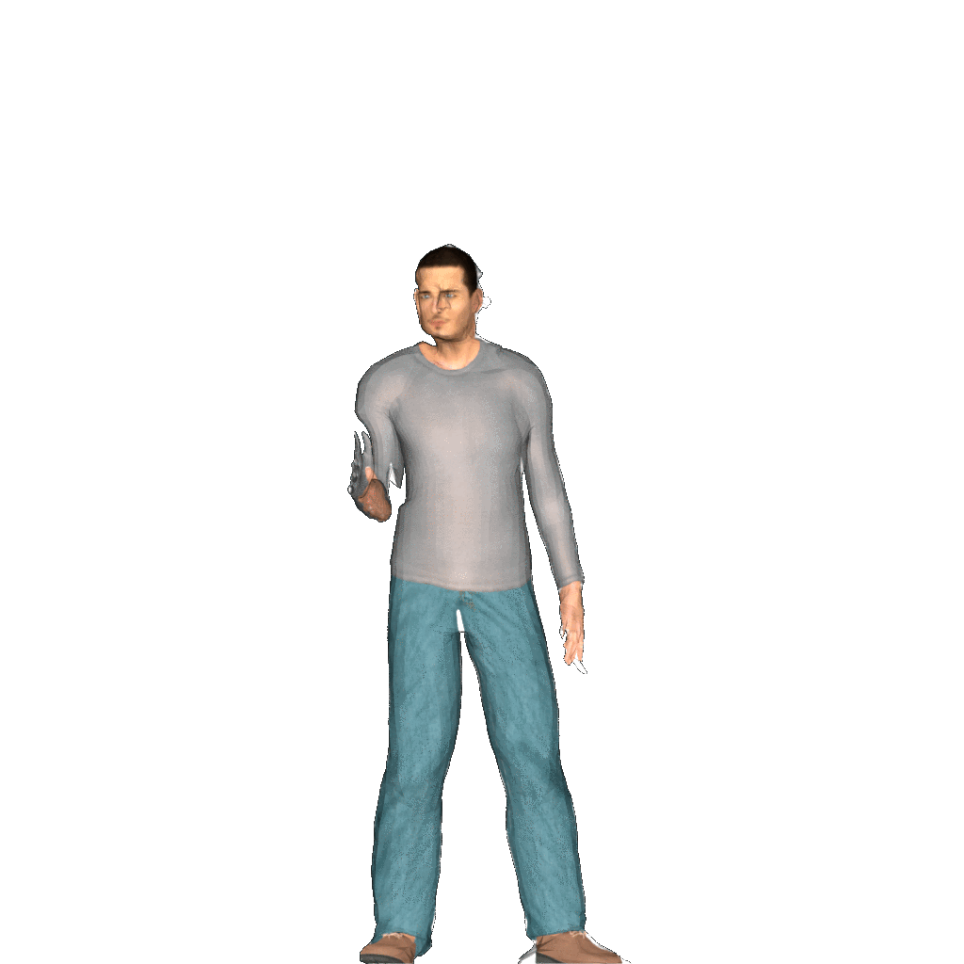

Slide 7
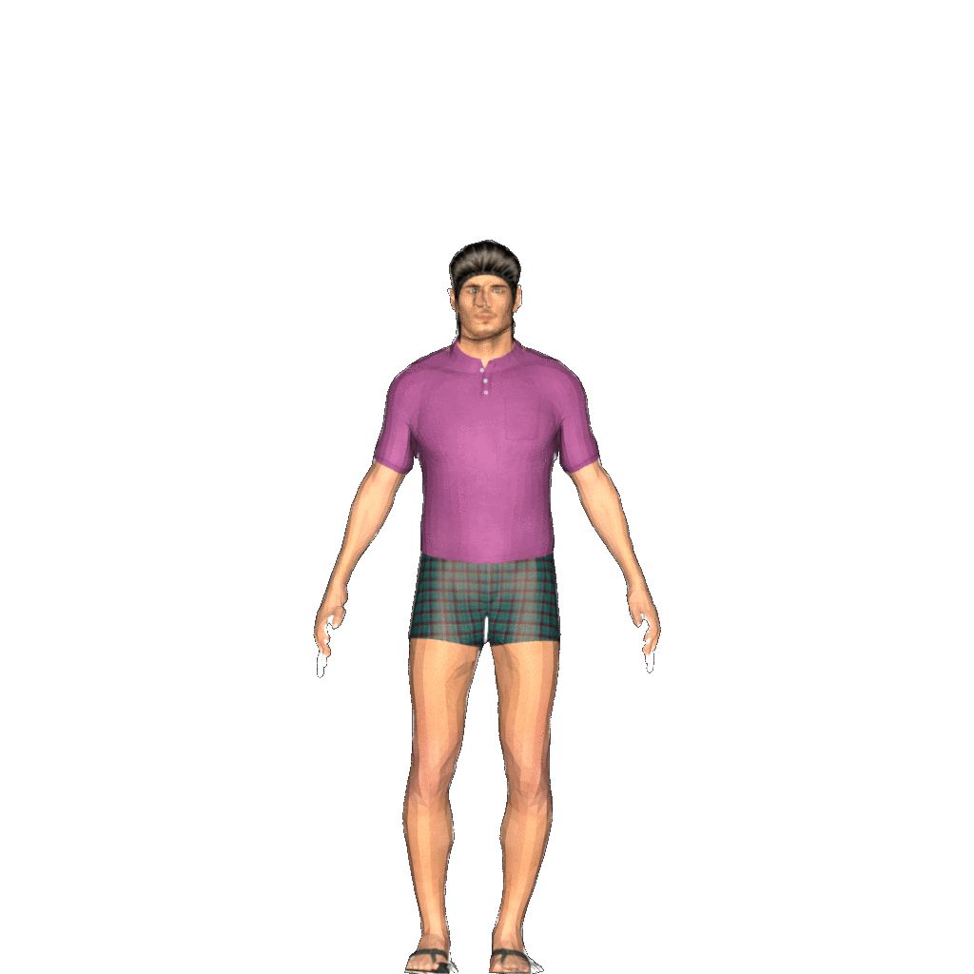

Slide 8
Middle-Level Details Recovery
Naked Body
Detailed Boundary
Detailed Body
Unsupervised
Aligned
Deform
UV Mapping
Supervised Training
Decoder
Encoder

Slide 9
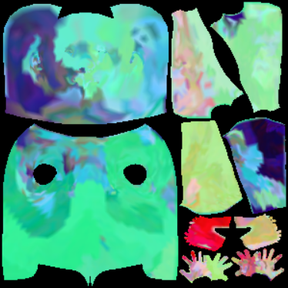
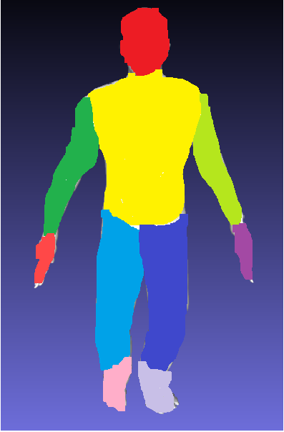

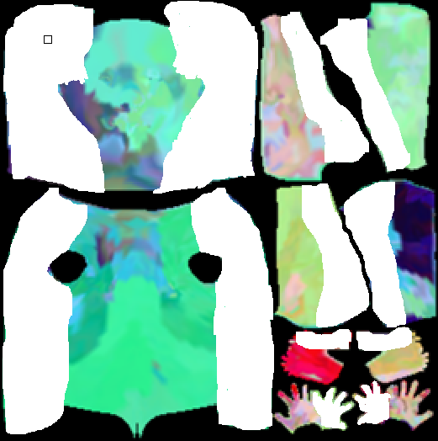
?
Middle-Level Details Recovery
Naked Body
Detailed Boundary
Detailed Body
Unsupervised
Deform
Aligned
UV Mapping
Parsing
Parsing
Supervised Training
UV Mapping
Semantic conditioned inpainter
Decoder
Encoder

Slide 10
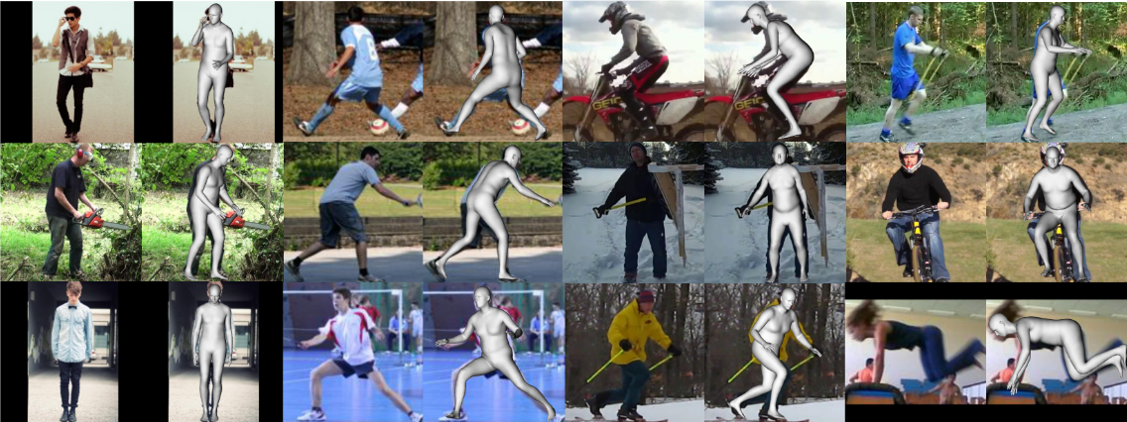
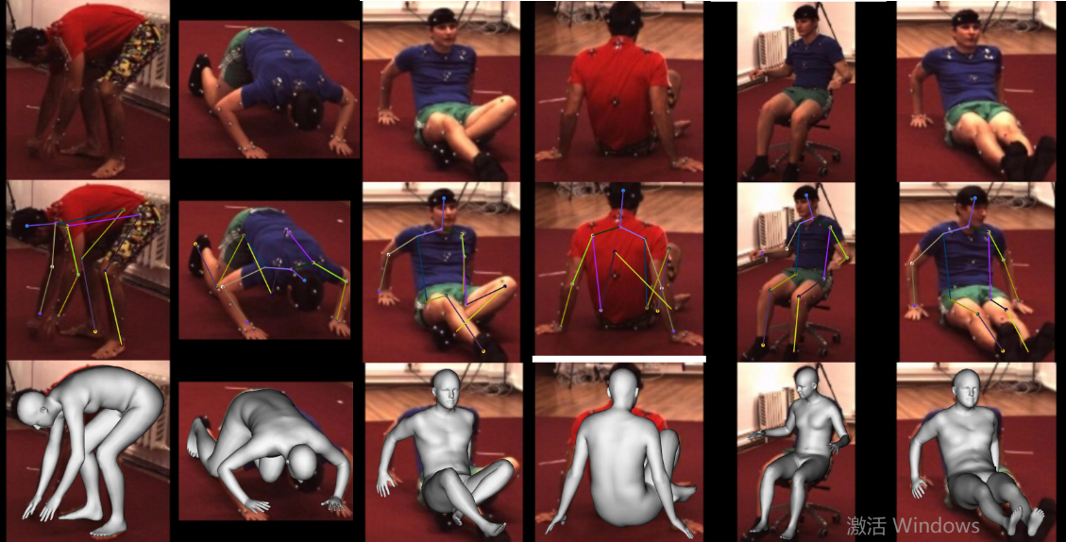
UP-3D
?
Dataset
Human3.6M→Mosh Dataset

Slide 11
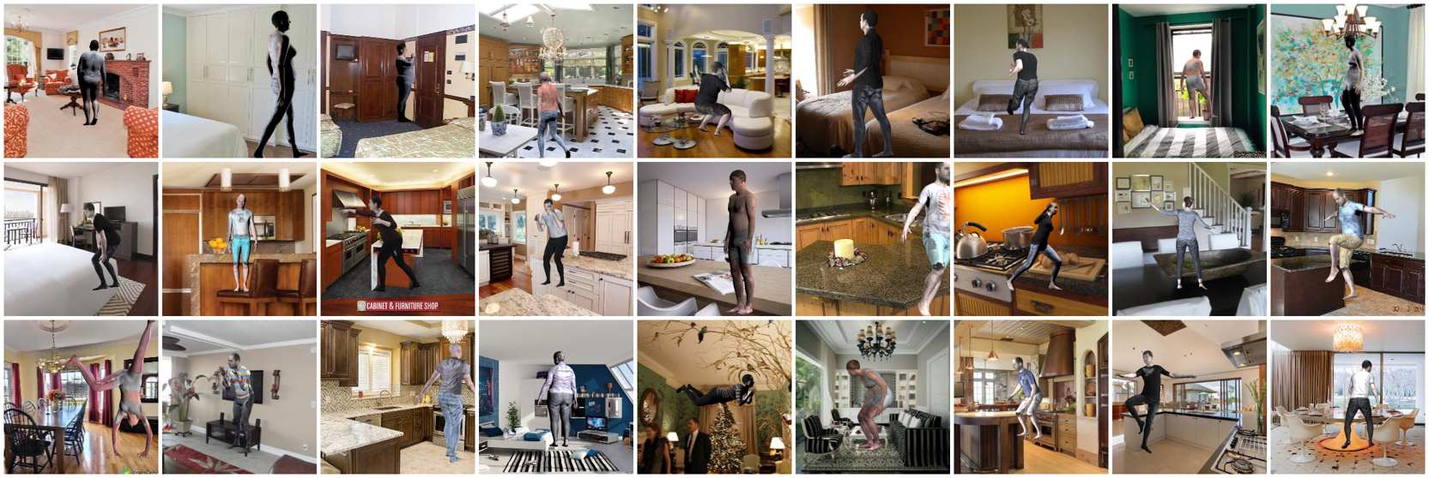
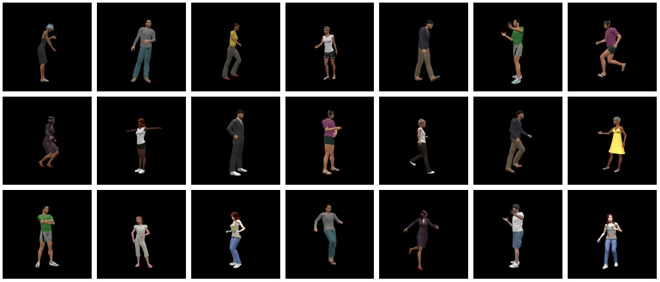
✔
Dataset
SURREAL: 1K clothings, 4K body shapes, 70K background images
PVHM: 10,200 pose-varying human mesh models, 22 different appearances, 200 to 1200 different poses.

Slide 12
Future Work
3D Skeleton Estimation (derived from SMPL directly)
Forecasting Human Dynamics (with Motion Synthesis)
Human Shape Prior (for Human-Object Interaction)
Novel-View Synthesis (for Robotics Vision)

